Slide 1
Building a New Future:
The Intersection of Strategy, Aerospace, and Prosperity
The Center for Strategic and Aerospace Studies
John A. Warden III

Slide 2
Overview
The Center, the Air Force and the Country can promote New Economic and Security gains
  Through Strategic Planning, Thinking and Execution
  Developed and Carried Out in “Open Planning” venues
  Using a Straight-Forward Strategy Methodology:
  “The Prometheus Process”
Other Groups and Entities can work with The Center to mutual advantage to advance Chilean interests in multiple areas

Slide 3


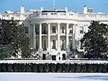

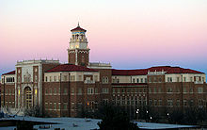

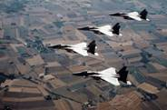





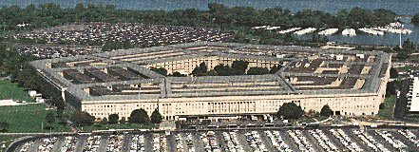


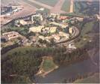

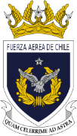
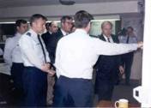
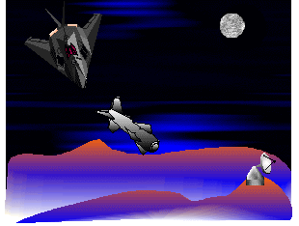


Development and Application of the Prometheus Strategy Process
US-Japan Manufacturing Technology Initiative
NEW VISTAS
Goals For America
New American Security Force

Slide 4
Prerequisites for Success
Three interrelated concepts, Key to the Success of any National, Institutional, or Business Undertaking:
  Good Strategy
  Open Planning
  Control Of Time

Slide 5


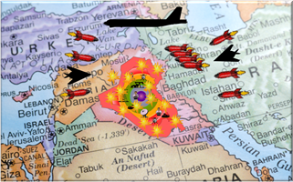

The Essence of Strategy
The Four Imperatives
Determine The Future You Intend to Create, then work backwards to Make it a Reality “The Future Picture”
Identify and Manage the Control Points which Provide The Best Return on your investments “Centers of Gravity”
Make Time your Servant by Compressing It Using it to Your Advantage
“Parallel Operations”
Know How to Move Beyond Successes and How to Deal with Set-backs
“Exit Points and Plans”

Slide 6
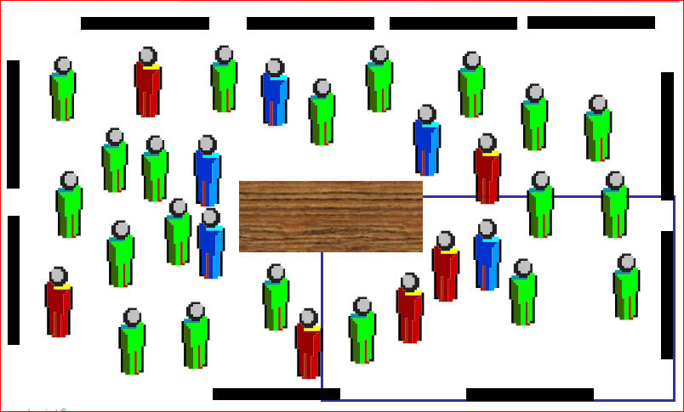
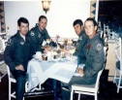
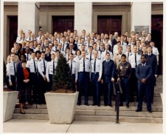
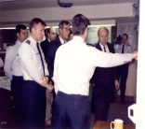
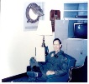




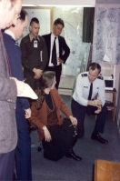






Plan and Operate In The Open

Slide 7

Time
Time Is The Enemy Of Enterprise
Success Is Most Likely In The Short Term
Parallel Operations Are Key To Mastering Time

Slide 8

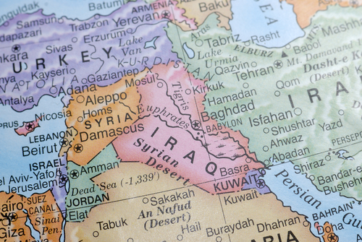

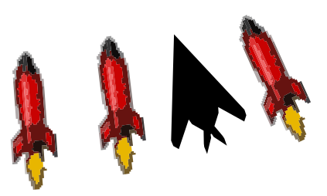
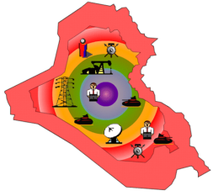

Control Time with Parallel Attack
Results in Days—Not months or years
Low cost in blood and treasure
System elastic limits broken
No Competent System Response
Parallel Effects Achieved
Parallel Attack Results

Slide 9
Chile Strategy Background
The National Security Environment
Little near-term concern over external State threats
Watchful eye on Non-state threats, such as Terrorism
Significant concern about Cataclysmic events such as Earthquakes, Volcanoes, Tsunamis, and Fires
Concern over Drug Traffic Control, especially on the borders with Perú and Bolivia.
  For the Immediate Future, Military Forces in Chile must be able to Manage the Last Two, effectively
  But a Latent Capability to Deal with the First Two, in the more distant future, is imperative
Notes:
Does terrorism belong to the first two or the last?

Slide 10
Chile Strategy Background
Aerospace in Today’s Security Environment
Air and Space Power indispensable to Counter “Conventional State Threats” and “Unconventional Threats”, such as Terrorism
Have High Utility for “Cataclysmic Events”
  Detection
  Rapid Response to Any Location
  Logistical, Communication and Medical Support
  Fire-fighting
Aerospace Technology and Development can make Major Contributions to “Economic Growth”
  Connectivity
  Tourism
  Trade

Slide 11
Chile Strategy Background
A Great Base for the Future
Chile Air Force: Recognized World-wide as a Highly Professional Service
Air Transport: Home of The Largest Airline Company In Latin America—and one of the World’s largest
Orbital Systems: Experience with Satellites and Observation
Mining and Exploration: Versed in Earth Sciences
Education: Many First-rate Schools, Universities, and Graduates
  Foundation for a world-class education system
Member of Alianza del Pacífico
  Potential for a joint Aerospace Initiative
Notes:
photos

Slide 12
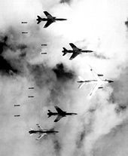
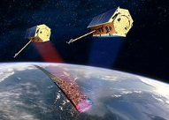
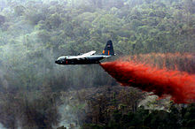
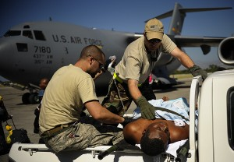
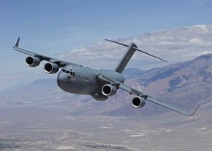
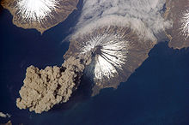

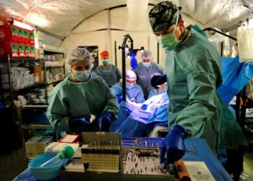
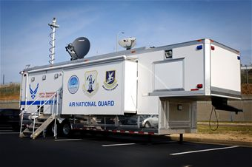

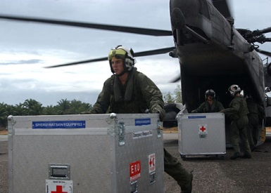
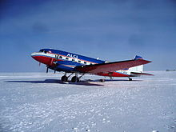

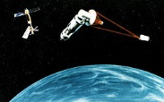

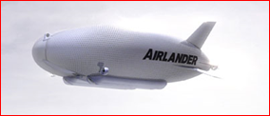
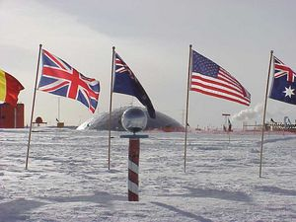

Chile Strategy Background
Aerospace: No Limits!
Notes:
Applications of the high-resolution TerraSAR-X radar imagery include:
Topographic Mapping: 2D and 3D, in scales down to 1:25,000, map updates
Surface Movement: Based on timeseries acquired by TerraSAR-X over the same area surface displacements caused by subsurface mining, oil-/gas extraction, infrastructure construction, excavations, or underground engineering can be visualised.^{[5]}
Change Detection: for the monitoring of large-scale construction projects, infrastructure networks, monitoring and documentation of changes and developments
Land Cover and Land Use Mapping: accurate and up-to-date land cover / land use informations, also from places, where it is difficult to get informations with using other technologies because of permanent cloud cover
Defence and Security Applications: Applications include effective mission planning, the quick assessment of natural or manmade disasters or border control through detection of paths (changes), fences and moving objects
Rapid Emergency Response: due to its rapid revisit time TerraSAR-X is a reliable source of information in case of natural or man-made disasters (e.g. earth quakes, floods, military conflicts etc.) providing reliable information for disaster management and response allowing the recognition and assessment of damages to populated areas and traffic infrastructure, the identification of focus areas, and an efficient coordination of rescue actions.^{[6][7]}
Environmental applications: e.g. forest monitoring, flood monitoring,^{[8]} water quality applications
Further applications currently under evaluation: Traffic Monitoring, Maritime applications, vegetation monitoring
Conventional
Disaster response (US, chile, haiti)
Detection—satellite photos
Rapid Response To Any Location
Logistical And Medical Support
Fire-fighting (photos)
Connectivity
Tourism (Virgin Galactic)
Trade (Fidae. Paris air show

Slide 13
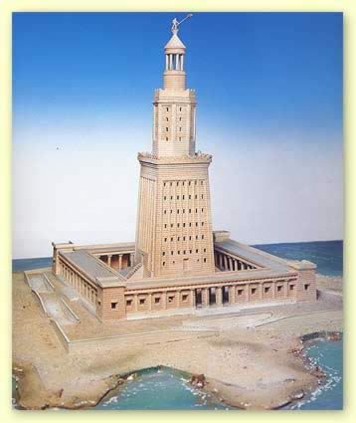
Building The Strategy
The Future Picture
Steady Beacon Toward which all are Steering
Clear, Compelling, Measurable
Meaningful Enough to Motivate
High Resolution
Timeframes (Short is Good)

Slide 14
An Aerospace Future Picture
The Air Force, The Government, Important Academic Centers and Key Business Leaders are Using Good Principles of Strategy to Create a Better Future for All
Chile excels in Aviation and Space-related Development, Manufacture, and Deployment of New Capabilities
  Especially Those that are Dual Use
Innovation in Aerospace Equipment and Concepts thrives in Chile with Emphasis on Disruptive Innovation
The Chilean Air Force plays a Key Role in Responding to Cataclysmic Events, while Maintaining More Traditional Military Security
Notes:
(Per Professor Clayton Christensen Of Harvard)

Slide 15

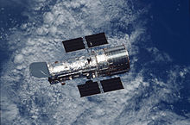
Realizing The Future Picture
WHAT Needs To Change
Your Future Picture
External Market System
Internal (Organization) System

Slide 16
Managing The Complex
--The Five Rings--
Leadership
Processes
Infrastructure
Population
Action Units
Notes:
Triggers:
Title
Iraq and Labels
Iraq Map
System Map & Labels
Comments:

Slide 17
Centers of Gravity
External to the Center
Leadership | Processes | Infrastructure | Population | Action Units
Key Business Leaders | Innovation | Investment Regulations | Officers | Companies
Key Air Force Leaders | Acquisition | Dual Use Regulations | Engineers | Government Agencies
Key Media (Newspapers and TV) | Innovation Development | Government and Military Organization | Business People
Key Government Leaders | Technology Acceleration |  | Reporters
Key Political Leaders | Dual Use Development
Key Think Tanks | Security Planning

Slide 18
Centers of Gravity
Internal to the Center
Leadership | Processes | Infrastructure | Population | Action Units
Center Director | Planning Process | Center Facility | Researchers | Center Divisions
Board of Directors | Idea Generation

Slide 19
Dual Use Center of Gravity
Expanded
Transport (Medical Aid, Key Equipment, Food, Evacuation, Support of Isolated Rural Areas, Mineral Exploration)
Communications (Coordination of Relief Activities, Access for Rural Populations)
Logistics (Knowhow, Base Capable of Handling Anything Required)
Detection/Reconnaisance (Drug Traffic Control, Geological Changes, Fires, Power Line Routing and Maintenance, Mineral Exploration)

Slide 20
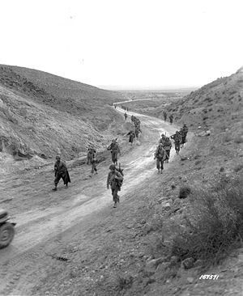
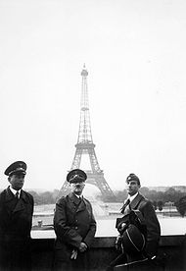
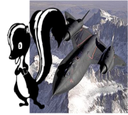



Affecting The System
Organization Change
New Objectives
New Situation
New Technology
Disruption
Try To Make Old Organization Work
Create New Organization
For Example:
French 1930’s
US Army 1942
US Auto Industry 1970s
For Example:
Germans 1930s
Lockheed Skunkworks
HP Inkjet Printers
Notes:
Triggers:
Title

Slide 21
Strategic Methods to Accelerate Aviation and Space Technology
Government and Military Acquisition Process: Emphasizes Fast Development of State-of-the-Art Systems:
    New Unmanned Air Vehicles for Dual Use
    New Joint-use Technology For Military and Commercial Application
    New Low Cost Space Applications
    New Fast, Inexpensive Infrastructure Technologies for Rapid Access and Operations in Remote or Damaged Areas
    Modelled on New American Security Force concept?
Big Audacious Program
  Like US Moon-shot in 1960s to focus efforts and generate enthusiasm

Slide 22
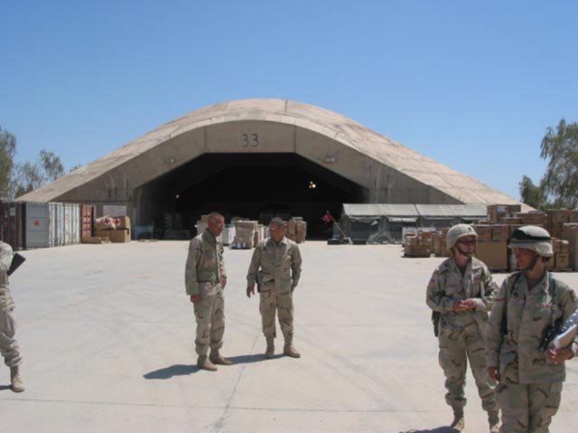

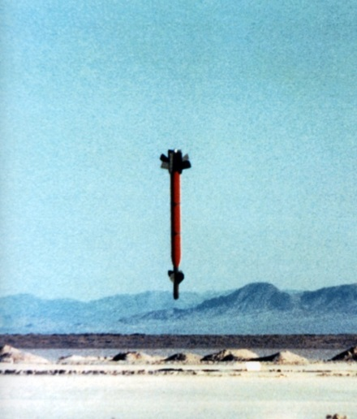
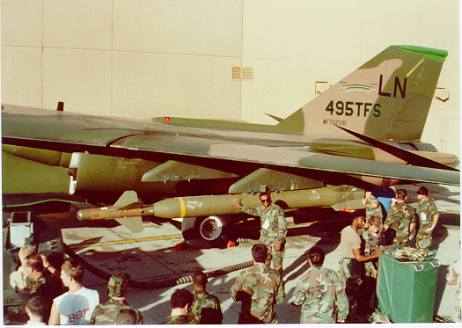
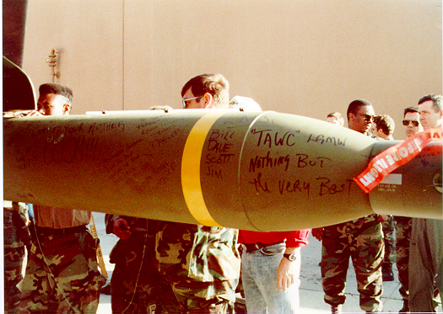
Fast-Time Development

Slide 23
Possible Strategic Methods to Inspire Innovation
The Skunkworks Approach
  F-80, U-2, SR-71, Minuteman II, F-117
  All Fast And Relatively Inexpensive
Government/Industry/University Cooperation
  Defense Advanced Research Program Agency
  Cooperative Research And Development Agreements

Slide 24
Air and Space as Technological and Economic Accelerators
Technological Capability and Knowledge are the Prime Determinants of National Prosperity and Growth
Success in Air And Space is Inextricably linked to Technological Expertise
  A Smart New Emphasis on Air And Space Development spurs Smart Technology Development in a Variety Of Fields
  Contributes Significantly to Increased Future Prosperity and Security In Chile
  Brazil’s experience is Illustrative
The Center For Strategy And Aerospace Studies
  Can And Should Play A Key Role
  Emphasis On Strategic Thinking
  Identification Of Smart Technology Paths

Slide 25
Strategic National Security Decision Making
Decision Making Tends to Be Based on Amending an Existing Procedure or System
  Results in Constant Replication of the Past
Much better to Work Back from a Desired Future
  Leads to New Concepts Specifically Designed for The Future, Not The Past
Working Back from The Future Promotes Genuine Joint Thinking
  Provides a Way to Go Beyond Existing Bureaucracies, to Find The Best Solutions
  Which May Not Require Participation by Every Division of The Bureaucracy

Slide 26
Summary
The Center for Strategic and Aerospace Studies, Along With its Counterpart Partners, Can Help Create a Dramatically Better Future
  In National Security, Civil Aviation, Military and Civilian Space, Technology, and Innovation
The Center and its Partners can introduce and use a Strategy Methodology to guide innovation and cooperation
The Center and its Partners can employ Open Planning on the widest possible scale
The Center and its Partners can promote the rapid change needed in today’s fast-moving world

Slide 27


Comments/Discussion
More Information
venturist®
Strategy For The 21st Century
John A. Warden III
Venturist, Inc.
8233 Old Federal Road
Montgomery, AL USA
http://venturist.com
jwarden@venturist.com
(01) 334-272-9800
José Miguel Moreno
Benjamín 2944, Oficina 21, Piso 2
Las Condes - Santiago
Teléfono 2333 04 90

